Slide 1
Programming Study C++11 14
NAM SOFTWARE

Slide 2
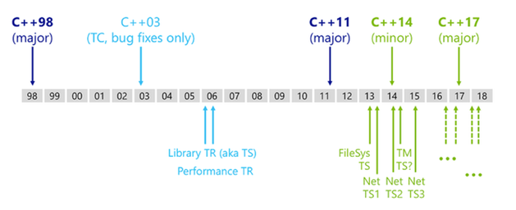
C++ standard …
https://www.infoq.com/news/2014/08/cpp14-here-features

Slide 3
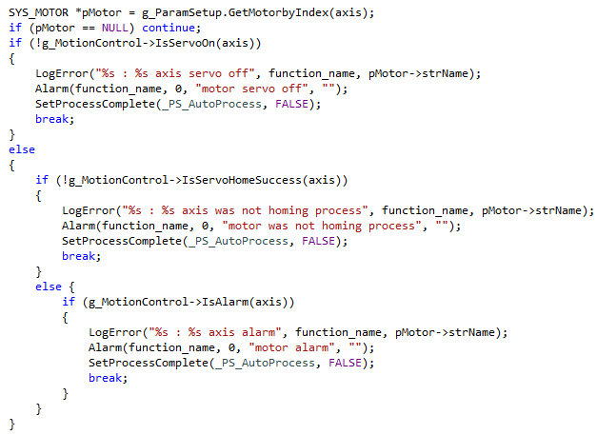
Lambda expression

Slide 4
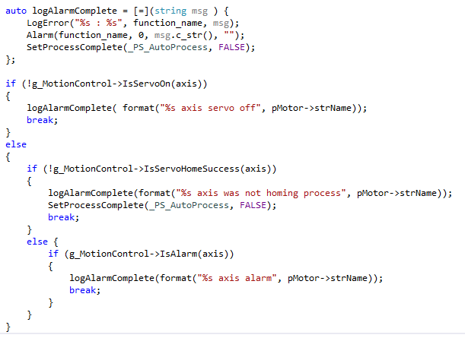
Lambda expression
[capture](parameters)->return-type {body}

Slide 5
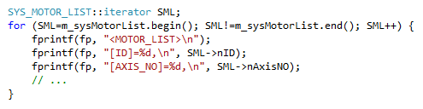
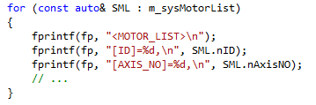
Lambda expression
[capture](parameters)->return-type {body}

Slide 6
Pointer
Usage
Constness
Memory Handling
Smart Pointer
Resource Handling

Slide 7
Usage
*a
&p
*p = 1
&p = 1
*a = &b

Slide 8
Constness
const function
const return
Put const whenever possible
And stick to it !

Slide 9
Memory Handling
new
delete
How to avoid memory leak ?
Try to avoid bare pointer as much as possible !

Slide 10
Smart Pointer
boost::shared_ptr
std::scoped_ptr
Understand scope rule !

Slide 11
Resource Handling
Resource Acquisition Is Initialization
> Custructor Acquires, Destructor Releases

